Slide 1
Lecture 8
Big Data

Slide 2


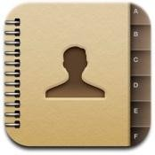

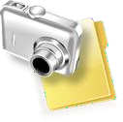
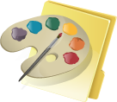


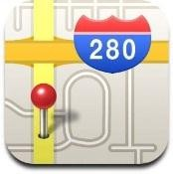

Our Data Now…
Personal Data
Emails, Calendars, Contacts, Location Information, etc…
Documents and Media

Slide 3

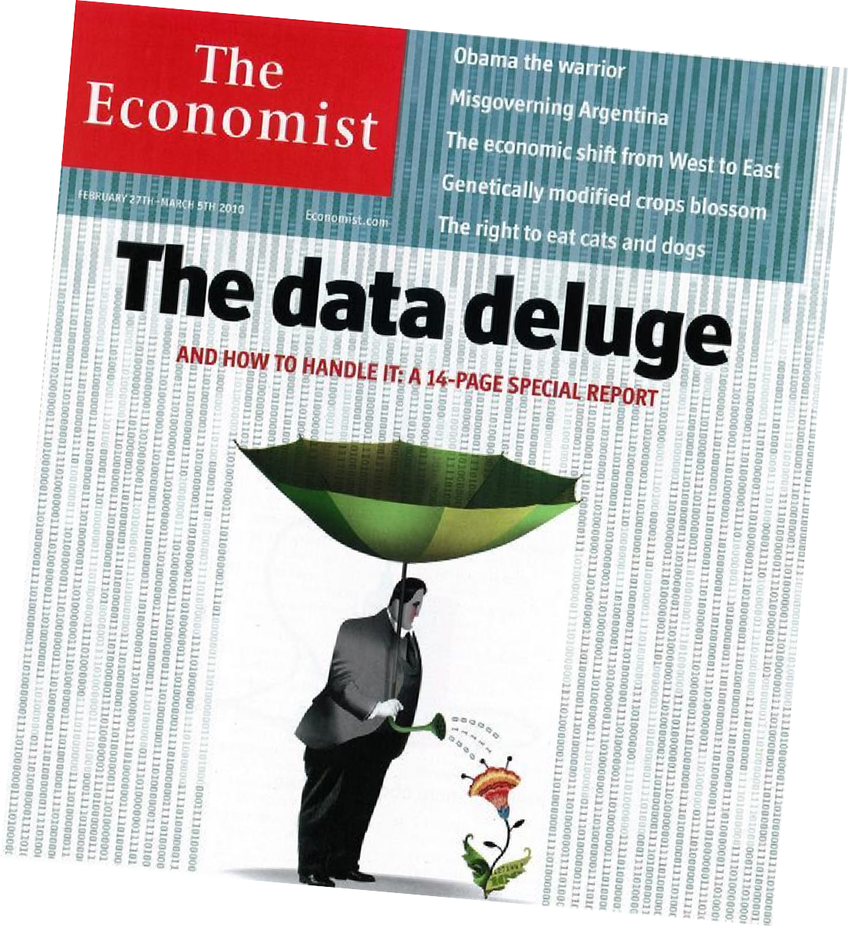


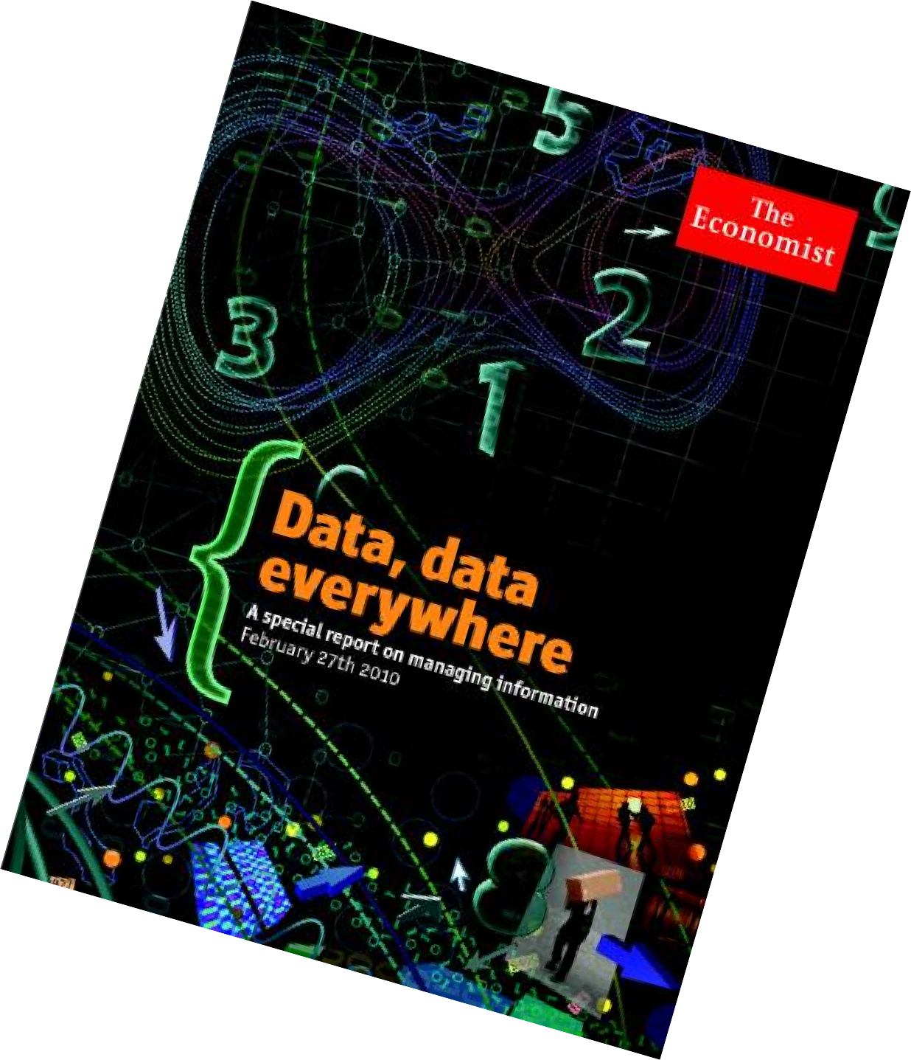
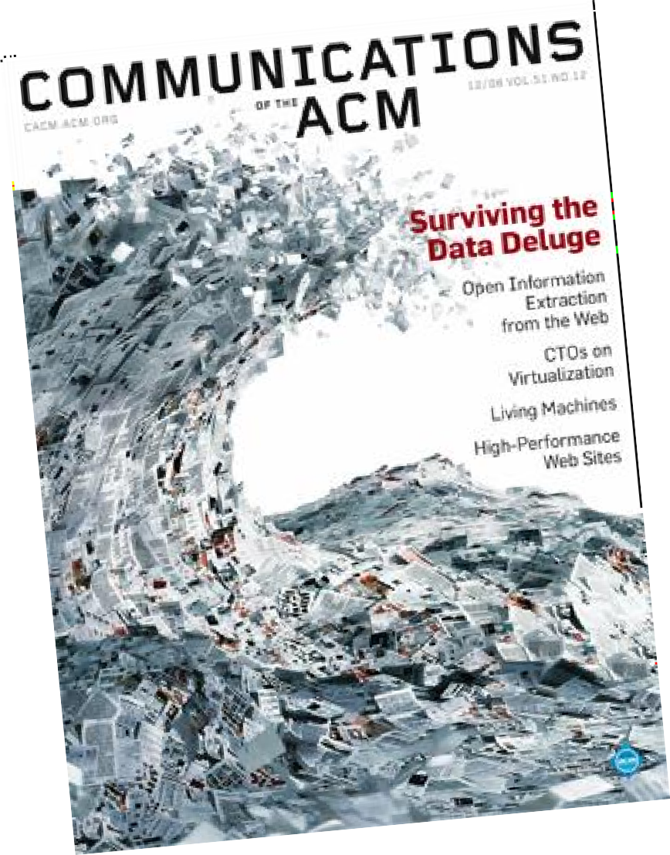
We Live in a World of Data…

Slide 4
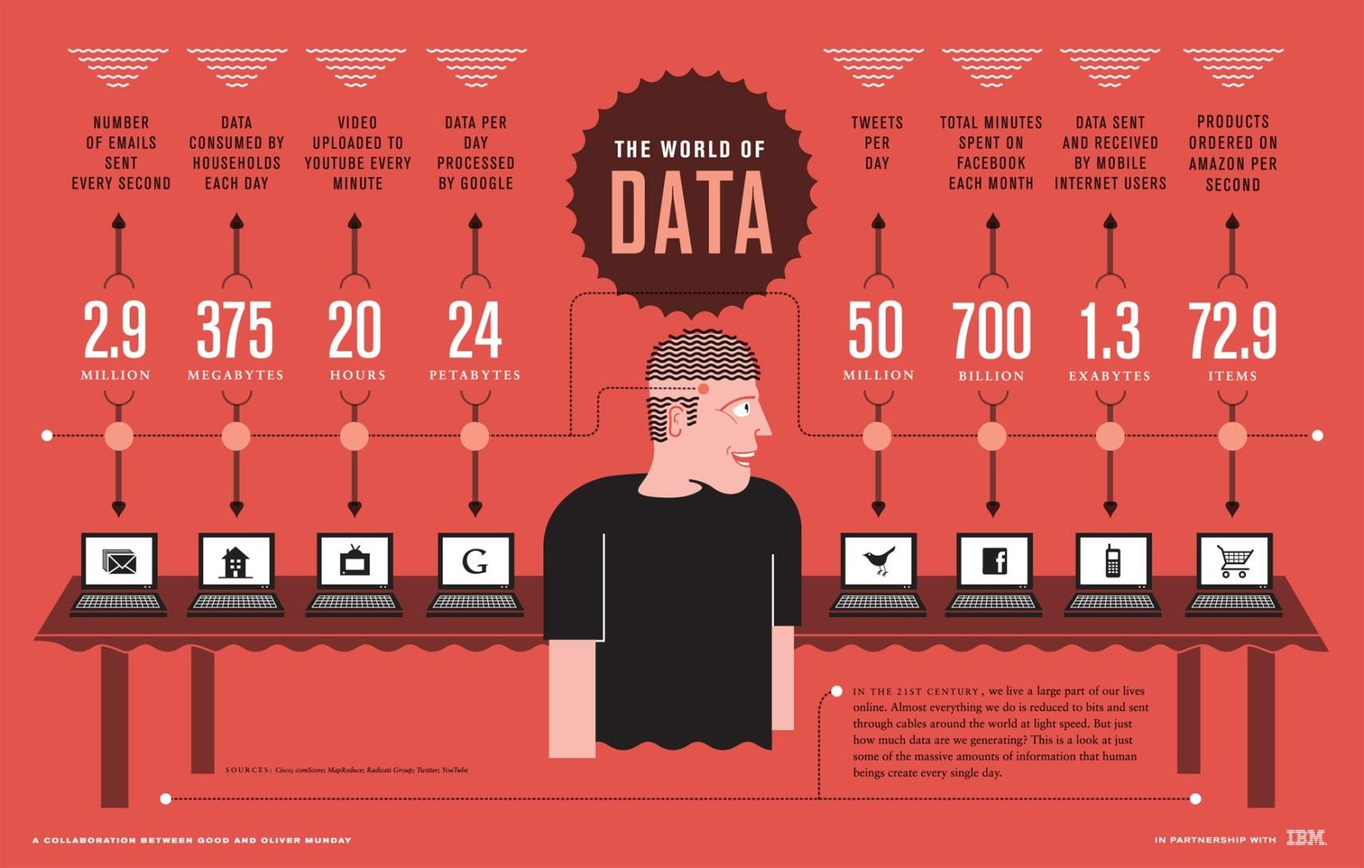
The World of Data

Slide 5
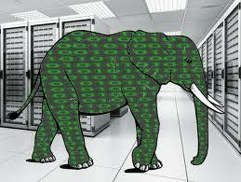
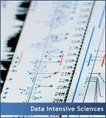
Big Data
Big data is defined as large pools of data that can be captured,
communicated, aggregated, stored, and analyzed.
Data continues to grow:
In mid-2010, the information universe carried 1.2 zettabytes and 2020
predictions expect nearly 44 times more at 35 zettabytes coming our way.
Applications are becoming data-intensive.

Slide 6



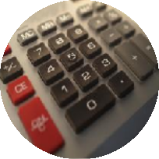
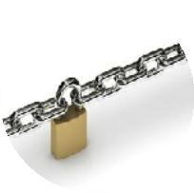
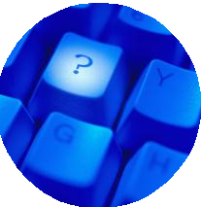
What Do We Do With Data?
Store
Share
Access
Process
Encrypt
…. and
more!
We want to do these seamlessly...

Slide 7
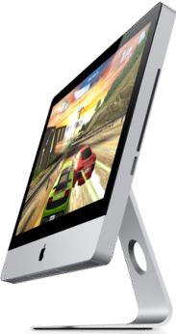
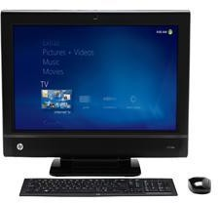
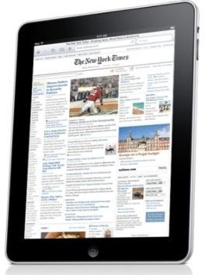
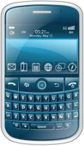
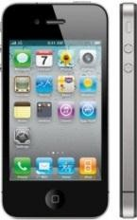
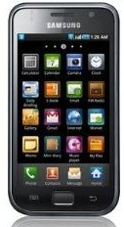
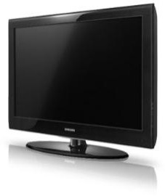
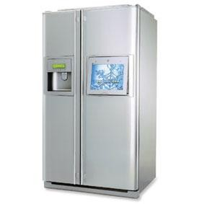
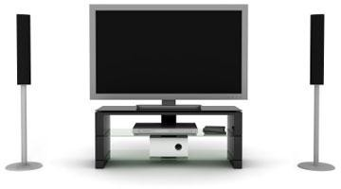
Using Diverse Interfaces & Devices
Desktops
Mobile Devices
…and even appliances
Consumer Electronics
We also want to access, share and process our data from all of our devices, anytime, anywhere!

Slide 8
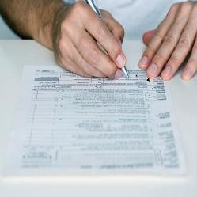
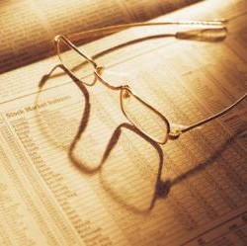
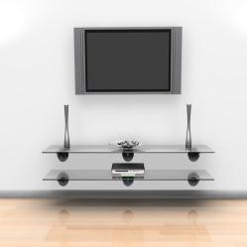
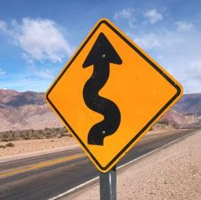
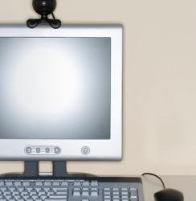
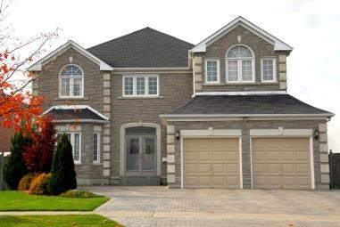
What About the Future?
How will you…
…work on documents?
…get your news & info?
…create, access, store and share media?
…navigate?
…communicate with friends and family?
…live in an intelligent home?
…

